Slide 1
TERMS AND CONDITIONS
These PowerPoint slides are a tool for lecturers, and as such:
YOU MAY add content to the slides, delete content from the slides, print out the slides, and save the slides onto your computer or server.
YOU MAY NOT resell, reproduce or redistribute the content in any form whatsoever, without prior written permission from the copyright holder.
© Troupant Publishers (Pty) Ltd, 2016
Selected images used under licence from Shutterstock.com

Slide 2
Engineering Systems
NQF Level 2

Slide 3
Safety measures relating to different engineering systems
Module 6

Slide 4
Electrical and electronic systems
Unit 6.1

Slide 5
Safety procedures
When to write safety procedures:
Designing a new job or task.
Changing a job or task.
Installing new equipment in the workplace.
Reviewing a procedure.

Slide 6
Safety procedures
Safety procedure should identify:
The supervisor and the employees.
The tasks that pose risks.
The equipment that is used in these tasks.
The control measures.
Any training or qualification needed.
The PPE to be worn.
Actions to be undertaken to address safety issues that may arise.

Slide 7
VIDEO: Personal protective equipment

Slide 8
Electrical systems
Dangers of
electricity
Figure 6.2 ‘Beware of high voltage’ sign

Slide 9
Types of injuries associated with electricity
The four main types of electrical injuries:
Electrocution.
Electric shock.
Burns.
Falls.

Slide 10
Electrical accidents
Common causes:
Inattention and carelessness.
Poor housekeeping.
Taking chances.
Overloading of electrical circuits.
Not complying with sound work practices.

Slide 11
Electrical accidents
Common causes:
Bypassing or ignoring safety procedures.
Lack of knowledge.
Fatigue.
Faulty or unguarded machinery.

Slide 12
Electrical safeguards
Examples of electrical safeguards:
Circuit-breakers.
Direct earthing.
Isolating transformers.
Double-insulated appliances.
Earth leakage units.

Slide 13
Safety precautions when working with or near electricity
Do not use power tools with faulty cords.
Do not use outlets or cords that have exposed wiring.
Use only cords or tools that are rated for the level of amperage or wattage that you are using.
Wet or damp areas have a greater risk of electric shock.
Know where the distribution board is.

Slide 14
Safety precautions when working with or near electricity
Ensure that all circuit-breakers are labelled.
Do not block access to circuit-breakers.
Do not use metallic ladders near power lines.
Lock out an isolator in the off position and place a tag on it.
Electrical accident: always disconnect the current first before attending to the accident.

Slide 15
Electric power tools
Basic safety measures for power tools
Work area (Safety)
Keep the work area and table clean and well lit.
Do not operate power tools in an explosive atmosphere.
Keep bystanders, children and visitors away while operating an electric power tool.

Slide 16
Electric power tools
Basic safety measures for power tools (continued)
Electrical safety
Never remove the earth wire or modify the plug in any way.
Do not use a power tool in rain or a wet environment.
Check that the plug is not cracked, broken or showing signs of burn marks before using it.
Regularly inspect cables for faults, damage, wear and tear.
Figure 6.4 Damaged cables

Slide 17
Electric power tools
Basic safety measures for power tools (continued)
Electrical safety (continued)
Use approved extension cables to extend cables.
Never carry or hold a power tool by its cable.
Keep cables away from heat, oil and sharp edges.

Slide 18
Electric power tools
Basic safety measures for power tools (continued)
Personal safety
Stay alert, watch what you are doing and use common sense when operating any power tool.
Do not use a power tool when you are tired or under the influence of drugs, alcohol or medication.
Dress appropriately – do not wear loose clothing or jewellery.
Keep long hair, clothing and gloves away from moving parts.

Slide 19
Electric power tools
Basic safety measures for power tools (continued)
Personal safety (continued)
Ensure that the power tool switch is off before plugging it in.
Avoid inhaling dust and chemicals or allowing chemicals to come into contact with your skin.
Remove adjusting keys or wrenches before turning the power tool on.
Always wear appropriate PPE.

Slide 20
Electronic systems
Basic safety measures for electronic systems
General safety precautions
Disconnect all power sources and discharge capacitors before working with an electronic system.
Ensure that you are properly grounded.
Study the schematic and wiring diagrams of the equipment on which you will be working.
Remove all metal items and jewellery.
Wear electrical safety shoes.

Slide 21
Electronic systems
Basic safety measures for electronic systems (continued)
General safety precautions (continued)
Never work alone and make sure you both know where to switch off the power.
Use test probes with safety guards or barriers on the tips.
Keep your body clear of any metal parts of the equipment on which you are working.

Slide 22
Electrostatic charges
Handling semiconductor devices
Handling semiconductor devices
Earth yourself with a wrist strap and a resistor.
Ensure that all mains-powered equipment is connected to the mains with an earth-leakage switch.
Equipment cases should be earthed.
Check packaging and manufacturers’ manuals for electrostatic discharge (ESD) warnings and instructions.
Do not touch or handle materials that create static charges without repeating the earthing action.

Slide 23
Electrostatic charges
Handling semiconductor devices (continued)
Handling semiconductor devices (continued)
Wear rubber-soled shoes.
Avoid working in a carpeted area when touching components. The floor area should be covered with anti-static material.
Keep static materials away from the workbench. Remove them before handling semiconductor devices.

Slide 24
Mechanical, hydraulic and pneumatic systems
Unit 6.2

Slide 25
Mechanical systems
Figure 6.11 Clothing can get caught in machinery

Slide 26
Mechanical hazards include:
Mechanical systems
Movement of parts – rotating, sliding or reciprocating.
Entanglement or catching hair, clothing or jewellery.
Friction and abrasion.
Cutting and shearing.

Slide 27
Mechanical systems
Mechanical hazards include:
Puncturing.
Impact.
Crushing.
Drawing in.
Compressed air or high-pressure fluids.

Slide 28
Non-mechanical hazards include:
Mechanical systems
Access problems.
Handling and lifting.
Electrical.
Chemical.
Fire and explosion.
Noise and vibration.
Temperature.
Radiation.

Slide 29
Machine guards
Figure 6.12 A guard fitted to prevent accidents

Slide 30
Types of machine guards
Fixed guards.
Interlocking guards.
Adjustable guards.
Self-adjusting guards.

Slide 31
VIDEO: Machine guard

Slide 32
Safety devices
The two main safety devices are:
Trip devices.
Two-handed controls.

Slide 33
Machine guards and safety devices
Table 6.1 Guards and safety devices
Type | Safeguarding action
Fixed guard | Provides a barrier that prevents hands or fingers reaching through, over, under or around the guard.
Interlocking guard | Prevents machinery from being operated unless the guard is in place.
Adjustable guard | Provides a barrier that may be adjusted to allow a variety of production operations.
Self-adjusting guard | Provides a barrier that moves according to the size of the workpiece entering the danger area.

Slide 34
Machine guards and safety devices
Table 6.1 Guards and safety devices (continued)
Type | Safeguarding action (continued)
Trip device | Stops a machine and makes it safe before or as a person approaches the danger zone.
Two-handed control | Both hands must be in a safe place before the machine can be activated; it should not be possible to operate both controls with one hand.

Slide 35
Why and how workers are injured by machinery
Why and how workers are injured by machinery
How serious machine related injuries occur
Badly designed machine guards.
Lack of adequate training for workers on the safe use of machines.
Poor maintenance of machines and guards.
A lack of guards.
Systems that encourage shortcuts.

Slide 36
Why and how workers are injured by machinery
Why and how workers are injured by machinery (continued)
How serious machine related injuries occur (continued)
Coming into contact with moving parts.
Getting trapped between moving parts of a machine or material and any fixed structure.
Being hit by material or parts that have been thrown out of the machine.

Slide 37
Where mechanical hazards occur
The point of operation.
The power transmission components.
Other moving parts.

Slide 38
General safety precautions relating to the use of machinery
Check the machine guards and safety devices regularly.
Ensure that control switches are clearly marked to indicate which machine they control.
Ensure that you are trained to work safely on machinery and that you wear appropriate protective clothing.
Make sure you know how to stop the machine before you even start it.

Slide 39
General safety precautions relating to the use of machinery
Inform your team leader if you think a machine is not working properly.
A dusty workplace can be dangerous.
Machines that are poorly located or that are too close together may not be safe, even if guarded.
With some machines, wear gloves to protect your hands from the sharp edges of the material being processed.

Slide 40
General safety precautions relating to the use of machinery
Never attempt to clean a machine in motion; switch it off or use a lock-out procedure.
Never use a machine that has a danger tag attached to it.
Do not wear jewellery, loose clothing or long hair as it may get caught in moving parts.
Adequate lighting is needed for the operation of machinery.

Slide 41
Hydraulic systems and tools
Do not operate a hydraulic system or tool unless thoroughly trained or under the supervision of an instructor.
Always wear safety equipment such as goggles, ear and head protection, as well as safety shoes when operating the tool.
Do not inspect or clean the tool while the hydraulic power source is connected.

Slide 42
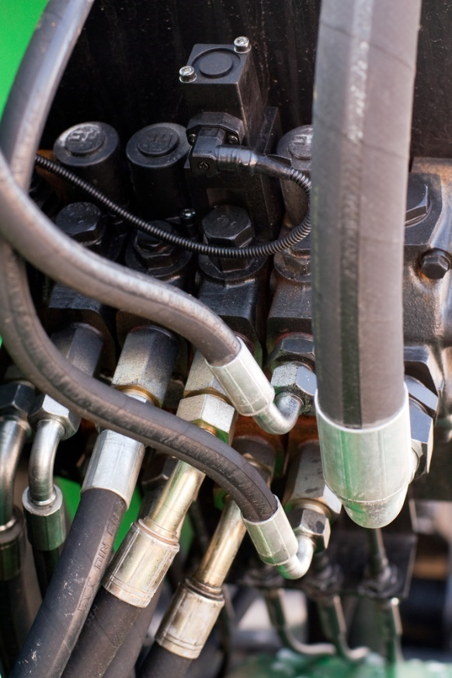
Hydraulic systems and tools
Ensure that all hose connections are tight.
Do not operate a damaged, improperly adjusted or incompletely assembled hydraulic system.
Do not exceed the rated limits of the tool or use the tool for applications beyond its design capacity.
Figure 6.16 Ensure that all hose connections are tight

Slide 43
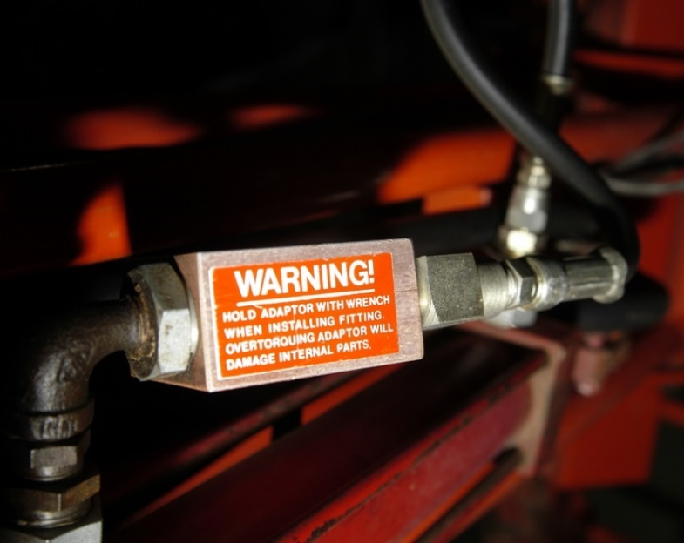
Hydraulic systems and tools
Always keep critical hydraulic system markings legible/visible.
Keep in mind that hydraulic power tools can produce an extreme amount of pressure.
Ensure that the surfaces are free of any oil.
Figure 6.17 A warning sticker on a hydraulic valve

Slide 44
Pneumatic systems and tools
Dangers associated with the use of pneumatic systems and tools
Dangers associated with the use of pneumatic systems and tools
Before operating a pneumatic system, inspect the air hose and check it for leaks or damage.
Blow air through the air hose to free it of foreign materials before connecting it to the tool.
Keep the air hose clean and free of lubricants.
Never point the air hose at another person.
Pneumatic tools must have complete lubrication.

Slide 45
Pneumatic systems and tools
Dangers associated with the use of pneumatic systems and tools (continued)
Dangers associated with the use of pneumatic systems and tools (continued)
When working continuously with a pneumatic tool, regularly check the lubricator.
Keep your pneumatic tools clean and lubricated and you will have few operating problems.
Wear safety glasses or goggles, or a face shield and other pertinent equipment.
Post warning signs where pneumatic tools are used. Set up safety equipment where necessary.

Slide 46
Pneumatic systems and tools
Dangers associated with the use of pneumatic systems and tools (continued)
Dangers associated with the use of pneumatic systems and tools (continued)
Use only the attachments that the manufacturer recommends.
Use the proper hose and fittings of the correct diameter.
Use hoses specifically designed to resist abrasion, cutting, crushing and failure from continuous flexing.
Ensure that hose connections fit properly.
Install quick disconnects of a pressure-release type rather than a disengagement type.

Slide 47
Pneumatic systems and tools
Dangers associated with the use of pneumatic systems and tools (continued)
Dangers associated with the use of pneumatic systems and tools (continued)
Attach the male end of the connector to the tool, not the hose.
Turn off the air pressure to the hose when not in use or when changing power tools.
Do not carry a pneumatic tool by its hose.
Avoid creating trip hazards caused by hoses laid across walkways or curled underfoot.

Slide 48
Pneumatic systems and tools
Dangers associated with the use of pneumatic systems and tools (continued)
Dangers associated with the use of pneumatic systems and tools (continued)
Do not use compressed air to clean dirt from clothes.
Take care when making operating adjustments to flow regulators.
Do not remove silencers, exhaust port filters and other types of port fittings while the system is pressurised.

Slide 49
The implications of non-adherence to safety measures as stipulated by the manufacturers
Severe bodily injury or loss of life.
Damage to or failure of the equipment.
Voiding of the warranty of the equipment.

Slide 50
Summative assessment
Test your knowledge of this section by completing the Summative assessment (page 99 of your Student’s Book)

